Slide 1


Code Academy AzMF201
Fuad Mammadov

Slide 2
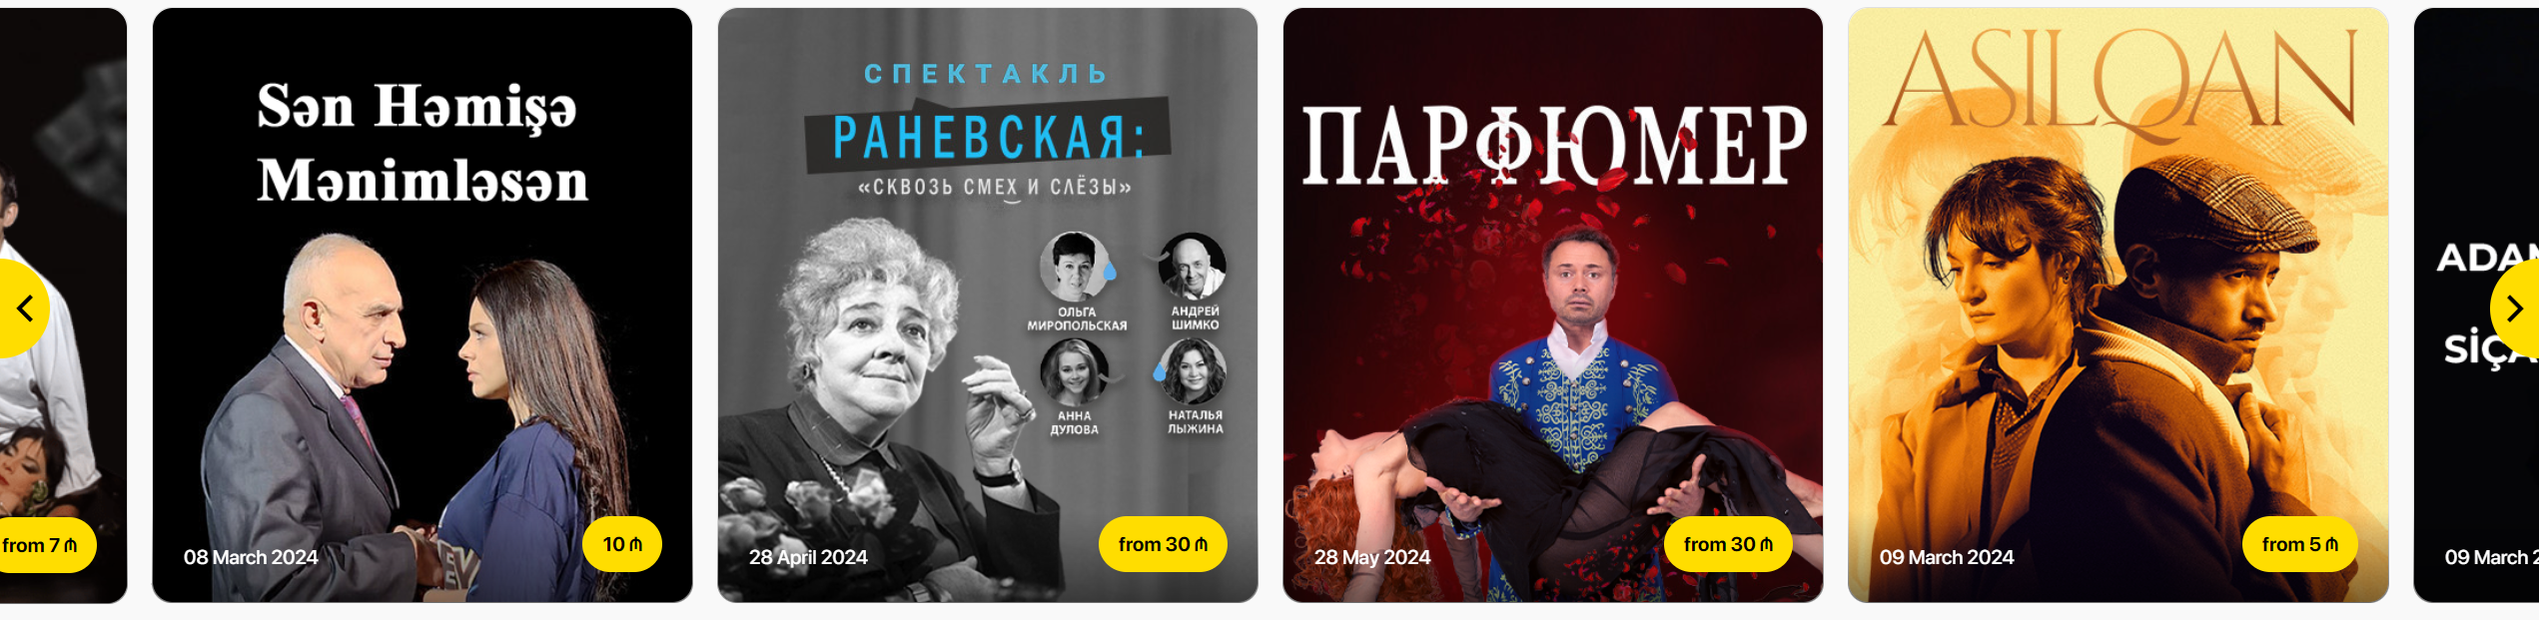

Home Page
Wishlist.
Events slider.
Popular.

Slide 3
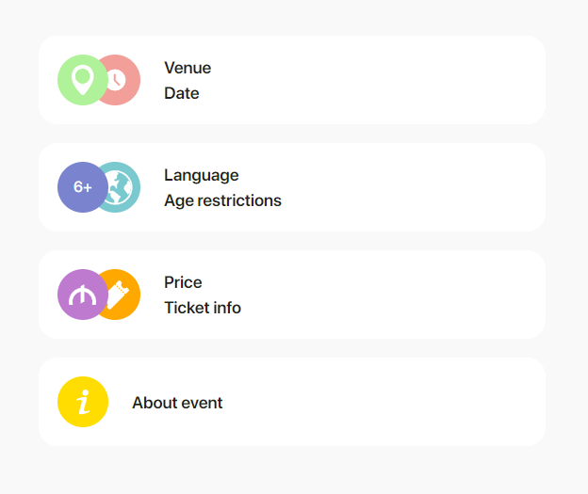
Detail Page
Venue
Language
Age restrictions
About event

Slide 4
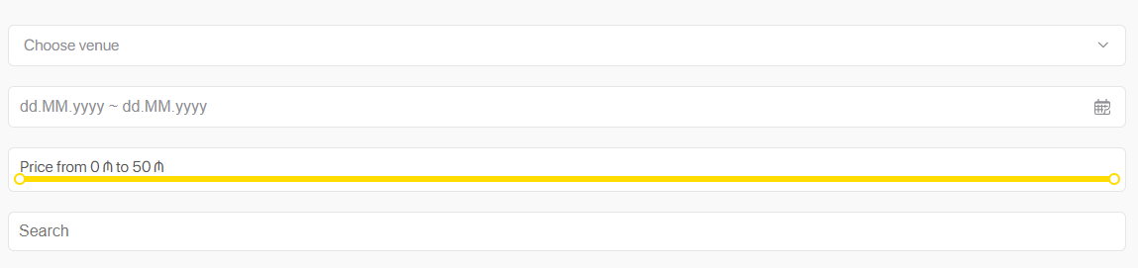
Category Page
Place Filter
Date Range Filter
Price Filter
Filter By Category
Search

Slide 5
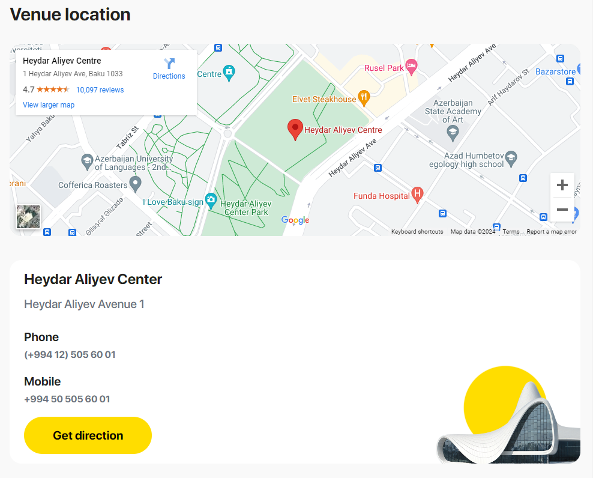
Venue
Embedded map
Address
Phone
Mobile

Slide 6








FrontEnd technologies
React Formik
React Suite
React
Vite

Slide 7





BackEnd technologies
820303

Slide 8
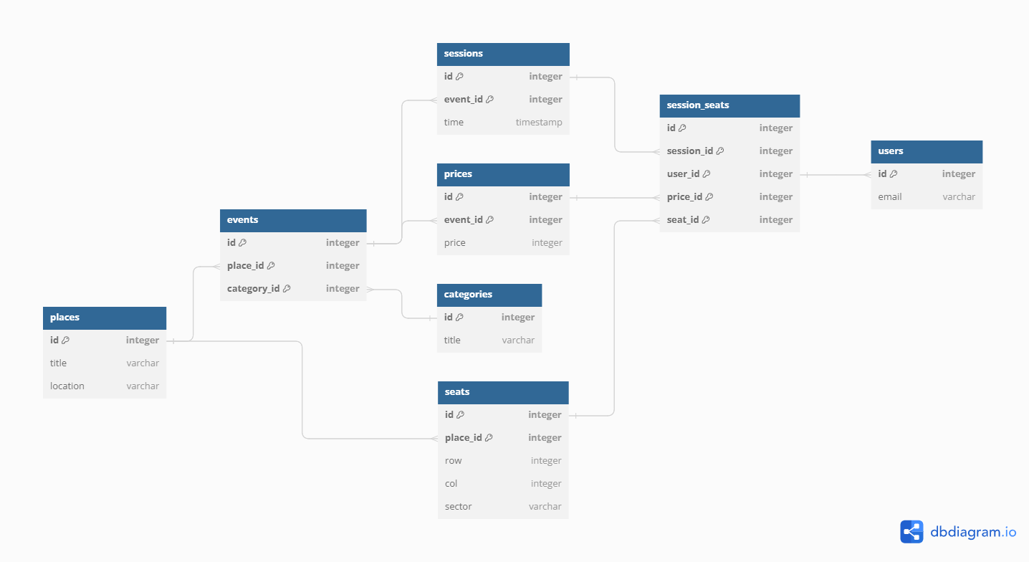
MongoDB diagram

Slide 9

thanks

